Slide 1





WELCOME
SE-223 PRESENTATION
TOPIC OF PRESENTATION
BASIC SQL, ALL JOIN AND SUB QUERY

Slide 2

TABLE OF CONTENTS
Basic SQL
Joins in SQL
Subqueries in SQL
Conclusion
SUBMITTED TO
Tapushe Rabaya Toma
Assistant Professor
Department Of Software Engineering
Daffodil International University

Slide 3

ABOUT ME
Name: Niher Ronjon Pramanik
ID Number:0242310005341102
Batch Number & SEC:40-D
Department Of Software Engineering
Daffodil International University

Slide 4


INTRODUCTION TO SQL
KEY FEATURES OF SQL
Structured Query Language (SQL) is used to manage and manipulate relational databases.
Data Manipulation
Query Language
Data Definition
Transaction Control
Security Features

Slide 5



IMPORTANCE OF SQL IN DATA-DRIVEN APPLICATIONS
CREATE DATABASE
Create
Use
Table Create
SQL is important in data-driven applications because it helps store, manage, and retrieve data easily and efficiently.
BASIC SQL COMMANDS
Select
Insert
Update
Delete

Slide 6

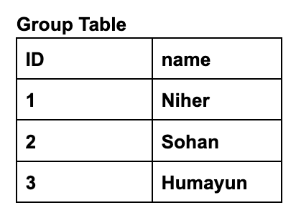
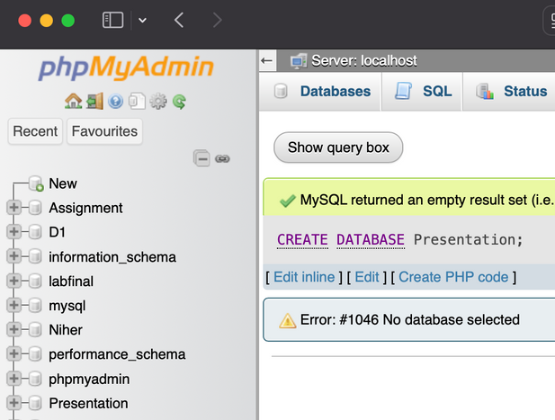

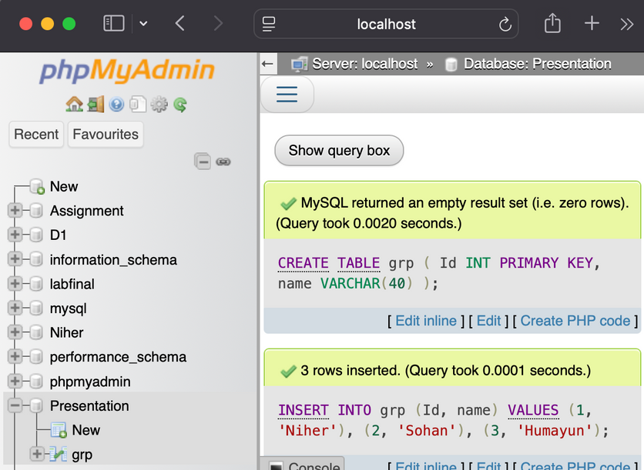
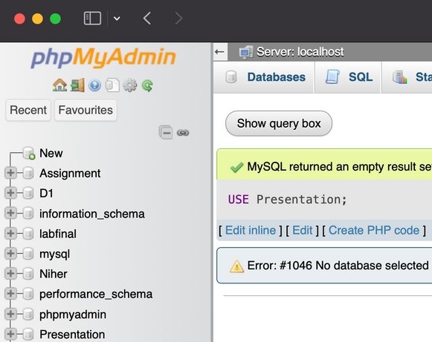
CREATE AND USE
TABLE CREATE VALUE INSERT
CREATE DATABASE (DATABASE NAME)
USE (DATABASE NAME)

Slide 7
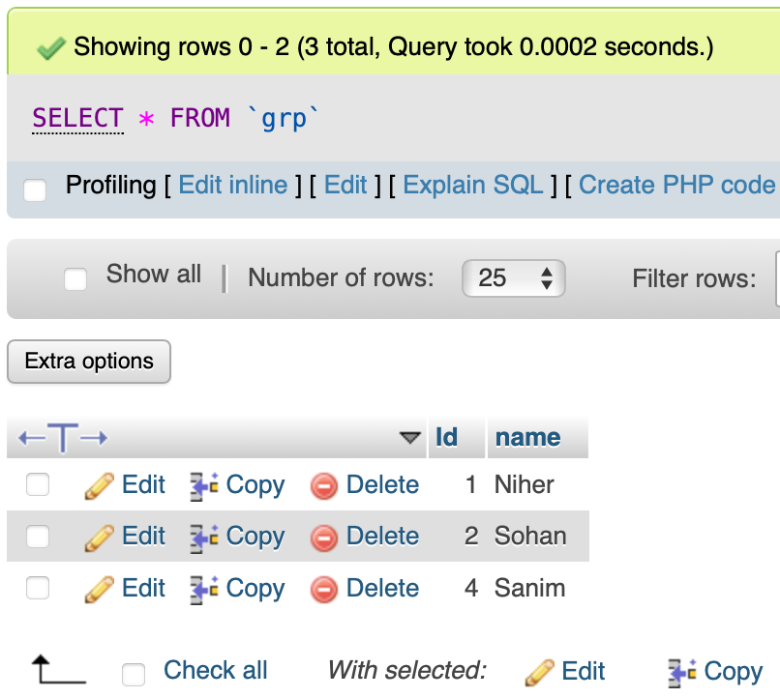
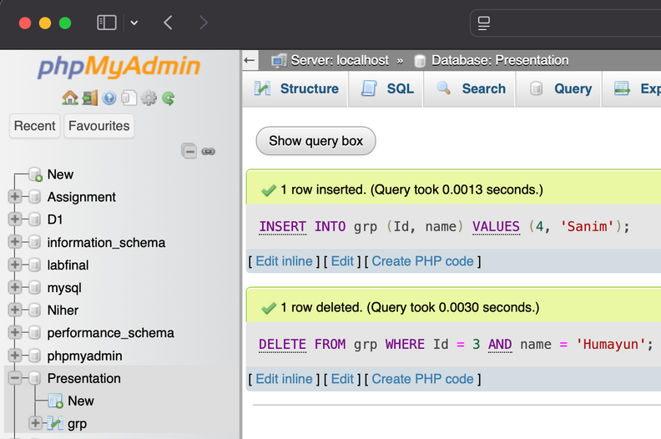
UPDATE & DELETE
OUTPUT
INSERT INTO grp (Id, name) VALUES (4, 'Sanim');
DELETE FROM grp WHERE Id = 3 AND name = 'Humayun';

Slide 8

INTRODUCTION TO JOINS IN SQL
JOINS IN SQL
DEFINITION
Joins in SQL are used to combine data from two or more tables based on a related column between them.
PURPOSE
To retrieve meaningful data that exists across multiple tables in a relational database.
Simplifies queries for complex datasets by eliminating redundancy.

Slide 9
TYPES OF JOINS IN SQL
COMPARISON TABLE
General Join
Inner Join
Left Outer Join
Right Outer Join
Full Outer Join
Join Type | Returns
INNER JOIN | Rows with matching values in both tables
LEFT JOIN | All rows from the left table; matching rows from the right
RIGHT JOIN | All rows from the right table; matching rows from the left
FULL OUTER JOIN | All rows from both tables
THE BASIC STRUCTURE
OF A GENERAL JOIN IN SQL
SELECT column_names
FROM table1
JOIN_TYPE table2
ON table1.column_name = table2.column_name;

Slide 10
customer_id | first_ name | last_ name | age | country
101 | Ahsan | Rahman | 30 | Bangladesh
102 | Nusrat | Jahan | 25 | Bangladesh
103 | Fahim | Ahmed | 28 | Bangladesh
SYNTAX FOR JOINING ‘N’ TABLES IN SQL
Syntax :
SELECT column_names FROM table1
JOIN table2
ON table1.column_name = table2.column_name
JOIN table3
ON table2.column_name = table3.column_name
...
JOIN tableN
ON tableN-1.column_name = tableN.column_name;
order_id | item | amount | customer_ id
201 | Laptop | 70000 | 101
202 | Smartphone | 30000 | 102
203 | Headphones | 5000 | 103

Slide 11
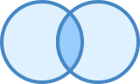
INNER JOIN
Definition:
Returns rows with matching values in both tables.
Syntax :
SELECT column_names FROM table1
INNER JOIN table2
ON table1.column_name = table2.column_name;

Slide 12
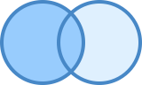
LEFT JOIN
Definition:
Returns all rows from the left table and matching rows from the right table. Non-matching rows in the right table are filled with NULL.
Syntax :
SELECT column_names FROM table1
LEFT OUTER JOIN table2
ON table1.column_name = table2.column_name;

Slide 13
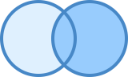
RIGHT JOIN
Definition:
Returns all rows from the right table and matching rows from the left table. Non-matching rows in the left table are filled with NULL.
Syntax :
SELECT column_names FROM table1
RIGHT OUTER JOIN table2
ON table1.column_name = table2.column_name;

Slide 14

FULL OUTER JOIN
Definition:
Returns all rows when there is a match in either table. Non-matching rows are filled with NULL.
Syntax :
SELECT column_names FROM table1
FULL OUTER JOIN table2
ON table1.column_name = table2.column_name;

Slide 15

What is Subquery?
Definition:
A subquery is a query nested within another SQL query, often used to compute intermediate results.
Purpose:
Break down complex problems into smaller, manageable pieces.
Enhance modularity and improve query readability.

Slide 16
COMMON USES
SELECT Clause: For derived columns.
WHERE Clause: To filter data based on results from another query.
FROM Clause: Used as a derived table or temporary dataset.

Slide 17
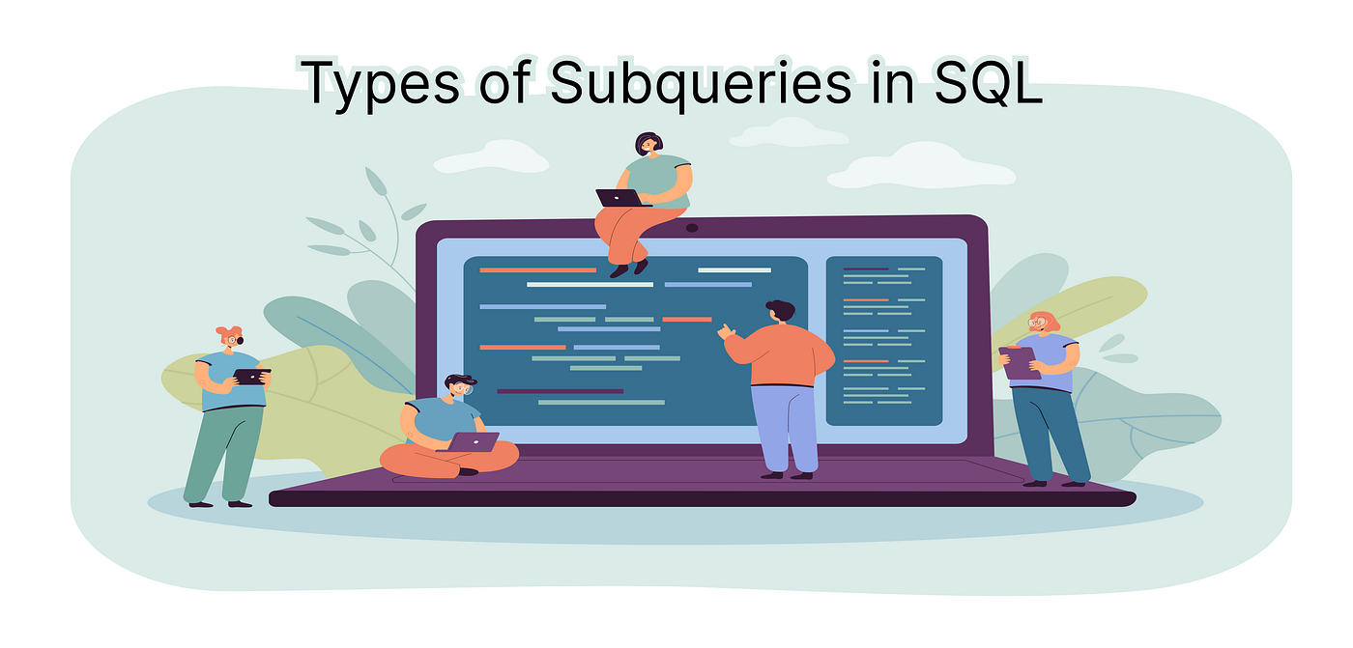

Slide 18
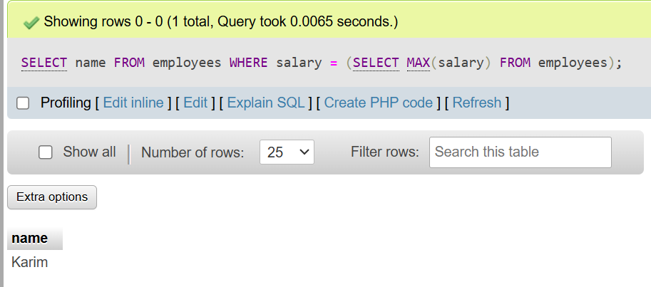
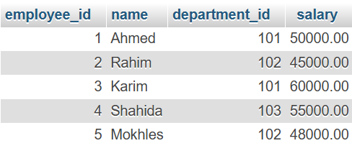
SCALAR SUBQUERY
A scalar subquery returns a single value. It can be used in situations where a single value is needed.
Example: Find the employee who earns the highest salary:
Here, the scalar subquery SELECT MAX(salary) FROM employees returns the highest salary

Slide 19
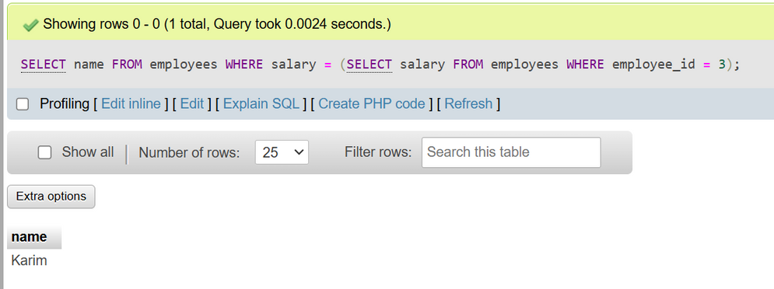
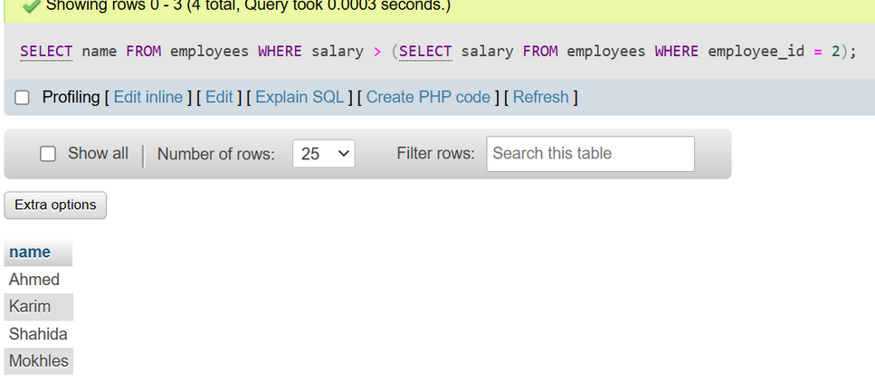
SINGLE-ROW SUBQUERIE
A single-row subquery returns a single row. It can be used with comparison operators like =, >, <, etc.
Example1: Find the employee whose salary is equal to the highest salary
Example2: Find the name of the employee whose salary is greater than the salary of the employee with employee_id = 2

Slide 20
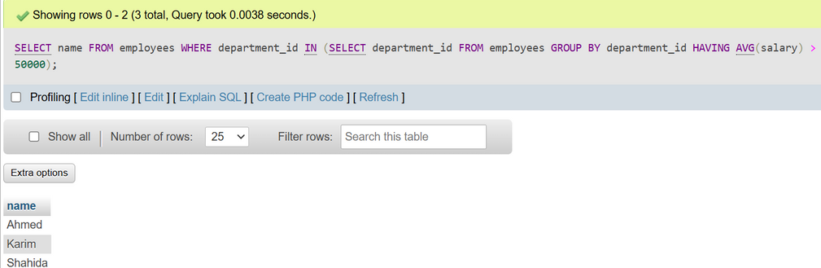
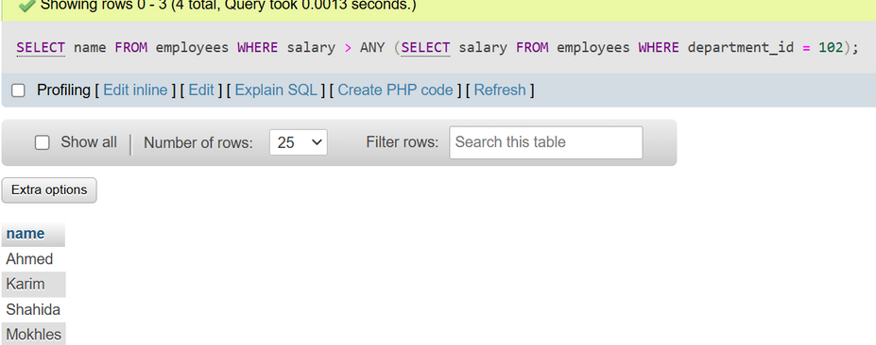
MULTI-ROW SUBQUERIES
A multi-row subquery returns multiple rows, typically used with IN, ANY, or ALL operators.
Example 1: Find employees working in departments where the average salary is greater than 50,000.
Example 2: Find employees who earn salaries greater than any employee in department 102.

Slide 21
CONCLUSION
SQL is a powerful language for managing and manipulating relational databases, allowing users to query, insert, update, and delete data. It provides efficient ways to organize and retrieve information using various commands and clauses. Mastery of SQL enables better data analysis and decision-making in any data-driven environment.

Slide 22




REFERANCES
GOOGLE
Wikipedia.com
Youtube.com

Slide 23

THANK YOU
ANY QUESTION..?

